Slide 1
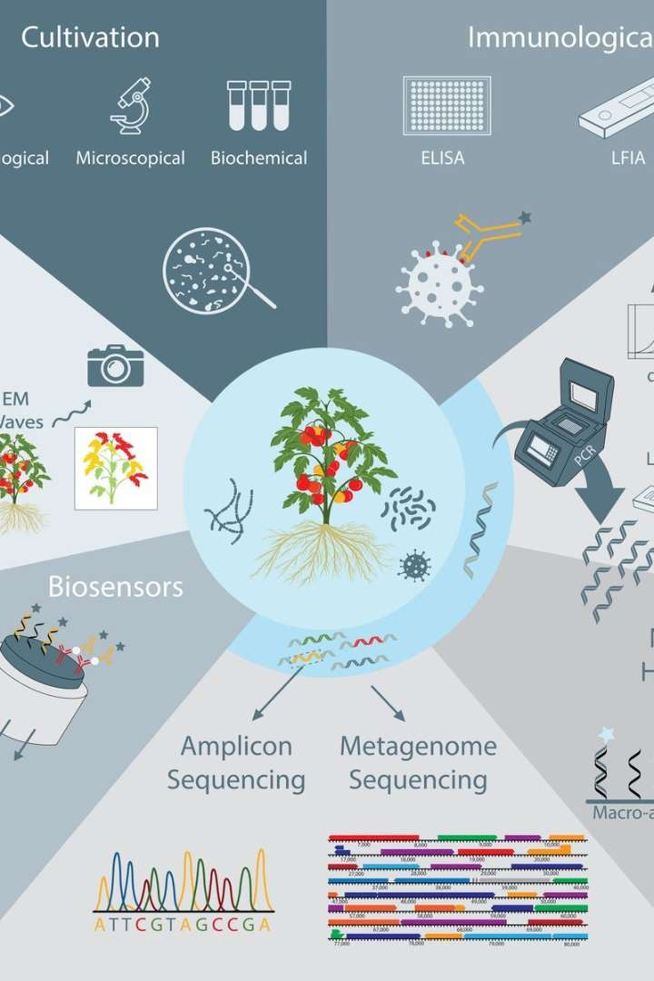
Introduction to Plant Disease Detection and Recommendation
In this presentation, we will explore the critical aspects of plant disease detection and recommendation. From common diseases to cutting-edge detection techniques and future prospects, this guide will provide a comprehensive overview of the s ubject.

Slide 2
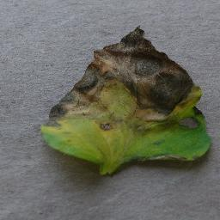
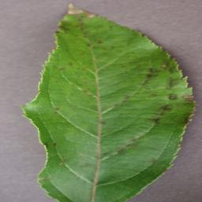
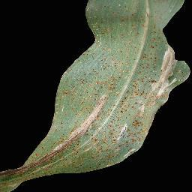
Common Plant Diseases and Their Symptoms
Blight Disease in Tomato
Plants
Blight is characterized by the appearance of brown spots on leaves, which eventually turn yellow and die. It also affects the fruit, leading to rotting and decay.
Apple Scab Disease
Symptoms
Apple scab causes dark, scabby lesions on leaves and fruit, leading to a significant reduction in fruit quality and yield.
Symptoms of Citrus
Canker
Citrus canker results in raised lesions on leaves, causing them to become distorted and drop prematurely, impacting overall tree health.

Slide 3
Techniques for Plant Disease Detection
Molecular Methods
Utilizing DNA-based techniques to detect pathogens at the molecular level, providing accurate and early disease diagnosis.
Remote Sensing
Utilizing drones and satellite imagery to monitor crop health, identifying subtle changes associated with disease presence.
Smartphone Apps
Integration of image recognition and AI algorithms to allow farmers to diagnose diseases directly from smartphone images.

Slide 4
Machine Learning Algorithms for Plant Disease Detection
1
Image R ecognition
Training algorithms to classify disease symptoms present in plant images, enabling automated diagnosis.
2
Pattern Analysis
Identifying subtle patterns and variations in leaf color and texture as early indicators of
disease presence.
3
Ensemble Methods
Combining multiple models to improve the accuracy and robustness of disease detection
systems.

Slide 5
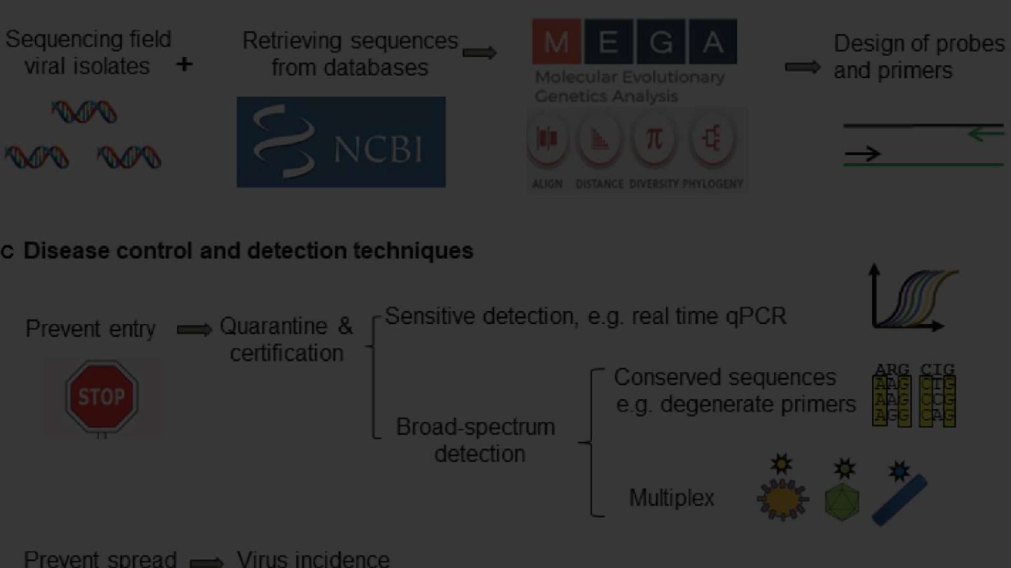
Importance of Early Detection and Prevention
1 2
3
Minimizing Crop
Losses
Early disease detection helps in taking prompt preventive measures, reducing the impact on crop yield.
Reducing Environmental Impact
Prevention reduces the need for heavy chemical application, promoting sustainable and environmentally friendly farming practices.
Economic Benefits
Early detection saves costs by minimizing the spread of diseases and the need for extensive treatments.

Slide 6
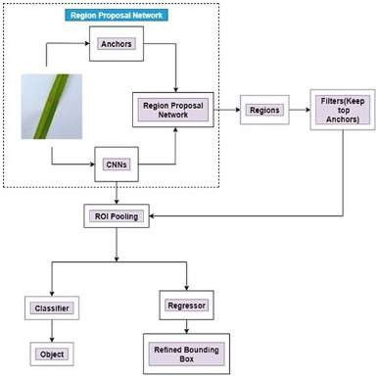
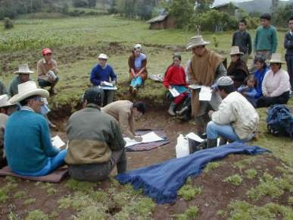
Recommendations for Plant Disease Management
Integrated Pest Management
Regular Monitoring
Farmer Training
Establishing routine surveillance to detect diseases early and take timely action to mitigate their impact.
Providing education and training to farmers on disease recognition, preventive measures, and sustainable farming practices.
Implementing a holistic approach, incorporating biological, cultural, and chemical control measures to manage diseases sustainably.
IMG query= "integrated pest
management in agriculture"

Slide 7

Case Studies of Successful Implementation
Case 1: Precision Agriculture
Integration of advanced sensors and data analytics to optimize disease management in
commercial farms.
Case 2: Community Surveillance
Engaging local communities in disease monitoring and reporting, leading to rapid response and control.
Case 3: AI-Enabled Diagnosis
Utilizing AI-powered systems to provide real-time disease diagnosis, benefiting small-
scale farmers and agribusinesses.

Slide 8
Future of Plant Disease Detection and Recommendation
Advancements in
Technology
Ongoing technological advancements will lead to more accurate and efficient disease detection systems for proactive plant protection.
Data-Driven Solutions
Global Collaboration
International cooperation and knowledge sharing will aid in developing comprehensive strategies for global plant disease management.
The integration of big data analytics and machine learning will further enhance the predictive capabilities of disease management tools.

